Slide 1
HealthFlex Exchange
Participant Workshops
Fall 2015
Notes:
This presentation is designed to provide a high level overview of the transition to HealthFlex Exchange for participants. More details about plans, health accounts (HRA/HSA) and the enrollment process will be addressed in the materials for the fall workshops.

Slide 2
Agenda
Overview
Changing Health Care Landscape and Needs
Conceptual Framework
Plan Choices
Defined Contribution (DC)
Health Accounts—HRA, HSA, FSA
Decision Support Tools
Plan Election “How-To”
Notes:
Today we are going to talk through HealthFlex Exchange—a new health plan product from the General Board of Pension and Health Benefits and our conference’s approach to health benefits for 2016.
We will be discussing these in sections—starting out by thinking about HealthFlex Exchange and health insurance as a whole, and then getting deeper into some of the new concepts, like “defined contribution” and different types of plans and health accounts that you’ll choose from during AE this year.
We will have a video to kick off and introduce each section, and then we’ll review the information and give you an opportunity to ask questions about each section of information.

Slide 3
Video Segment A

Slide 4
What Is HealthFlex Exchange?
Same trusted, quality group health plan and many features as today
Key Differences
More plan choices
Greater flexibility to “shop”
Increased control over costs
Better alignment with needs
Greater decision-making supports
Notes:
Before we kick off the video and the detailed sections, we want to briefly talk about what HealthFlex Exchange is:
It’s the same group health plan—HealthFlex—that we have had through the General Board in the past. It’s not an individual plan or a government plan. There are a few key differences though that we will highlight throughout our time today:
--you’ll have more choices of plans come November (5 medical, 3 dental, 2 vision) to meet your individual needs.
--you’ll have a fixed amount of money from the conference/local church to offset your premium costs. This is called a defined contribution and we will talk more about it later.
--you’ll see exactly the premium cost differences between each HealthFlex plan, and be able to weigh the up front cost with the potential out of pocket cost over the year to make your plan selection.
The conference is offering this new opportunity as a response to a changing health care environment. The Affordable Care Act is requiring that we handle health benefits a bit differently—including making them less generous in terms of what employer-insurance can cover. By giving you more choice over the plan that is best for you, we hope to make that transition (which is happening all over the country) more positive for you and your family.

Slide 5
Changing Health Care Landscape
Affordable Care Act (ACA)
2018—Cadillac Tax imposes high penalties for “generous” health plans
Public Marketplace (www.healthcare.gov) introduces to consumer public:
Individual choice
“Metal plans”
Comparative shopping for health insurance
Notes:
A little bit off background detail about the Affordable Care Act (sometimes called “Obamacare”). There are two key parts of this Act that have driven the need for change to our health care benefits.
First: there is an excise tax (sometimes called a Cadillac tax) on high-cost plans beginning in 2018. To avoid a sudden drop off of benefits, our conference wants to begin to offer plans that cost less—and therefore have less generous benefits—in advance of 2018. We want to do this in a way that empowers you rather than just takes something away
Second: the public marketplaces (through Healthcare.gov) have introduced the concept of “shopping” for health insurance, comparing plans and prices, and the concepts of gold, silver, and bronze level plans. We are not transitioning to the public marketplace, but these are concepts that we want to incorporate.

Slide 6
Changing Health Care Landscape
Consumerism and Accountability
Cost-sharing and transparency facilitate informed decisions about care options
Improved cost sustainability
Most expensive plan—not best fit for everyone
Notes:
In addition to the Affordable Care Act, it has been found that having some cost share for health services can help raise awareness and create wiser decision making when it comes to using health care.
Behavioral economics tells us when something seems “free” (or fully covered by our health plan with no cost share)—we don’t really think much about whether we “need” it or whether it is the best use of our money. But if we have a share in the cost, we might think harder about the best way to use our money. This might mean choosing a generic over a brand medication, asking a physician if a treatment is necessary or the most cost-effective, or seeking a second opinion to ensure medical necessity. This can lead to lower health plan costs for each individual as well as the Church/conference. It can also lead to better health outcomes, as we become more engaged consumers of health care.
We also know that not everyone needs the most expensive plan.

Slide 7
HealthFlex Strategic Direction
Alignment with ACA strategy and policy
Avoid Cadillac tax
Ensure minimum value of coverage, benefit adequacy
Continued migration toward “consumer” plans
Overall plan value below “Cadillac plan” threshold
Greater individual accountability
More choice and flexibility to meet individual needs
Greater cost sustainability for plan sponsors

Slide 8
HealthFlex Exchange—Conceptual Framework
More Plan Options
5 Medical/Rx • 3 Dental • 2 Vision Options
YOU “Shop” for Plan with “Credit” (defined contribution)
Higher premiums, lower out-of-pocket
Lower premiums, higher out-of-pocket
More premium owed
Less premium owed
Premium costs offset by “credit” (fixed defined contribution)
Defined Contribution (“credit”) > Premium = “Excess” deposit to: HRA or HSA
Premium > Defined Contribution = Salary Deduction
(Medical, Dental, Vision)
Notes:
Conceptually:
(Orange): At AE, you’ll choose from 5 medical/pharmacy plans, 3 dental and 2 vision plans. Some are more costly up front with less out of pocket when you use services (gold) and some are less costly up front but have more out of pocket when you use services (silver).
(Purple): The church/conference will designate the same defined contribution amount for everyone in your situation (e.g. clergy), which will act as a “gift card” toward the purchase of your health plan. If you select a plan that costs more than your defined contribution is worth, you will pay the difference via pre-tax salary deductions. If you choose a plan that costs less, you may owe nothing (if less than your defined contribution) or a lower amount. If you have leftover “DC” dollars that you do not spend on premium, you will keep them to use for out-of-pocket health care expenses via a health reimbursement account or health savings account, depending on the plan you choose.
(Green): Your share plus your church’s share combine together to pay your full HealthFlex premium.

Slide 9
HealthFlex Exchange: Same Quality
BCBSIL or UnitedHealthcare
OptumRx (formerly Catamaran)
United Behavioral Health
VSP and CIGNA
HealthCash for activity, screening and Wellness Points
Avoid higher deductible by taking HQ
Same Health Plan Partners
Same Wellness Incentives
Same Provider Networks
Same Award-Winning Wellness Programs
No narrow networks or restrictive formularies
WebMD, Virgin Pulse, Quest, Evive Health and more
Notes:
Here are some of the things that are staying the same:
1) Our vendors aren’t changing, so you don’t have to worry about your doctors suddenly not being covered.
2) Our provider networks and drug formularies aren’t changing. In the public marketplace (healthcare.gov), sometimes we see that the networks are narrow and formularies are limited, which means not as many doctors or medications are covered. That is not the case here. The same broad nationwide networks and broad formularies will still be available through any HealthFlex plan you choose.
3&4) You’ll have access to the same wellness programs and incentives that you always do through HealthFlex.

Slide 10
HealthFlex Exchange: More Choice
More Flexibility
More Options
More Support
Medical/Rx, dental and vision options
5 medical/pharmacy plan combinations
3 dental choices
2 vision choices
Align plan with personal needs
Medical needs
Financial situation
Comfort with unexpected expenses
Guidance for plan selection
WebMD’s Coverage Advisor (September)
MyChoice decision support
Telephone support
Notes:
But you’ll have more choice and be empowered to choose the plan that best fits your personal needs.
You’ll choose from 5 medical/pharmacy plan combinations, plus 3 dental and 2 vision plans. (Even if you didn’t have dental before.)
You can pick a plan that aligns with your personal needs. Maybe you have limited savings and a limited ability to handle an unexpected ER bill or hospital bill—you might want to pay more each month for the security that you won’t have to pay as much if something major happens. But maybe you have ample savings and not a lot of expected medical costs—you may want to pay less each month for a plan with more out of pocket exposure so you don’t over-insure yourself. It’s up to you.
And HealthFlex will give you tools like WebMD’s Coverage Advisor and the MyChoice tool during Annual Election to help guide you through your choices, if you wish. If you need more support, you can also talk to someone for more assistance.

Slide 11
HealthFlex Exchange— Not a Government Exchange
HealthFlex Exchange
Public Exchange(s)
Broad networks
Nationwide networks
No age-band rating
Important for clergy at or above our average age (>50)
Non-taxable plan sponsor contributions
Wellness programs and related incentives always included
Narrowed networks
Up to 75% of doctors could be omitted; can be difficult to assess this before selecting plan
Age-banded rating
Premiums vary up to 3x by age
No pre-tax funding
Tax credits for those who qualify (not everyone)
No wellness wraparound
Notes:
It’s important to realize that HealthFlex Exchange is VERY DIFFERENT from a public/government exchange, which is why we have decided to go this route and continue offering group coverage instead of eliminating our health plan like some UMC annual conferences have done.
Some key differences:
-network “size”
-uniform cost for all clergy/participants regardless of age
-allows us to continue to offset with pre-tax funding (not possible with the public exchanges—has to be taxable)

Slide 12
Video Segment B: Plans

Slide 14
Included in All HealthFlex Plans
Preventive care covered at 100%
Plan specific embedded pharmacy plan benefit
Embedded “gold” behavioral health benefit (regardless of benefit plan chosen)
Combined medical-pharmacy out-of-pocket maximum; new for 2016 maximum amount paid by participant varies by plan
No lifetime maximum benefit
Wellness programs and incentives

Slide 15
Types of Medical Plans
PPO
B1000
CDHP
C2000 (Gold) | C3000 (Silver)
HDHP
H1500 (Gold) | H2000 (Silver)
Co-pay | Fixed co-pay for office visits; then 100% coverage | N/A | N/A
Deductibles | Medical—deductible for other medical services; then % co-insurance Rx—no deductible | Medical—deductible for all medical services (higher than PPO), then % co-insurance Rx—no deductible | Combined medical and Rx deductible— higher than PPO; then % co-insurance
HRA/HSA | No Plan Sponsor Funded HRA/HSA (Please note: excess Defined Contribution is put into an HRA) | HRA—plan sponsor-funded; partially offsets increased deductible exposure | HSA—plan sponsor-funded; optional participant contributions; helps offset increased combined deductible exposure
Out of Pocket Maximums | Yes; combined medical and Rx deductible, co-payments and co-insurance | Yes; combined medical and Rx deductible, co-payments and co-insurance | Yes; combined medical and Rx deductible, co-payments and co-insurance

Slide 16
PPO vs. CDHP vs. HDHP— Health Accounts Comparison
PPO
CDHP—with HRA
HDHP—with HSA
Eligible Expenses | N/A | Medical/Rx, behavioral health, dental, vision | Medical/Rx, behavioral health, dental, vision
Account Funding | N/A | Plan sponsor contributions only | Plan sponsor contributions; optional participant pre-tax contributions
Interest | N/A | No interest earned | Earns interest (similar to bank account)
Portability | N/A | Stays with plan | Belongs to participant
Health Account Compatibility | Full-use FSA Full-use HRA (excess DC for HRA) | Full-use FSA Full-use HRA | Limited-use FSA Limited-use HRA (for existing balance) dental and vision expenses only

Slide 17
“Gold” Plans: At A Glance
Gold PLANS
B1000—Rx: P1 | C2000 (with HRA)—Rx: P2 | H1500 (with HSA)—Rx: P3
Wellness Visits | 100% | 100% | 100%
Office Visits | Co-pay, then plan plays 100% | Deductible, then plan pays 80% | Deductible, then plan pays 80%
Other Medical Services | Deductible, then plan pays 80% | Deductible, then plan pays 80% | Deductible, then plan pays 80%
Behavioral Health | Co-pay, then plan pays 100% | Deductible, then plan pays 80% | Deductible, then plan pays 80%
Prescription Drugs (Rx) | Not part of deductible; participant pays 20% co-insurance (min/max applies) | Not part of deductible; participant pays 25% co-insurance (min/max applies) | Deductible; then participant pays 25% co-insurance (min/max applies)
Plan Sponsor Funding | N/A | HRA Single: $1,000 Family: $2,000 | HSA Single: $750 Family: $1,500

Slide 18
“Silver” Plans—At A Glance
SILVER PLANS
C3000 (with HRA)—Rx: P2 | H2000 (with HSA)—Rx: P4
Wellness Visits | 100% | 100%
Office Visits | Deductible, then plan pays 50% | Deductible, then plan pays 70%
Other Medical Services | Deductible, then plan pays 50% | Deductible, then plan pays 70%
Behavioral Health | Deductible, then plan pays 50% | Deductible, then plan pays 70%
Prescription Drugs (Rx) | Not part of deductible, participant pays 25% co-insurance (min/max applies) | Deductible, then participant pays 25% co-insurance (min/max applies)
Plan Funding | HRA: Single: $250 Family: $500 | HSA: Single: $500 Family: $1,000

Slide 19
Benefits Summary Deductible, Co-insurance and OOP Maximum
B1000 “Gold” Rx: P1 | C2000 “Gold” Rx: P2 | H1500 “Gold” Rx: P3 | C3000 “Silver” Rx: P2 | H2000 “Silver” Rx: P4
Deductible Individual Family | $1,000 $2,000 | $2,000 $4,000 | $1,500* $3,000* | $3,000 $6,000 | $2,000* $4,000*
Co-insurance (Plan Pays) | 80% | 80% | 80% | 50% | 70%
Out-of-Pocket (OOP) Maximum (Includes Medical and Rx Deductible) Individual Family | $5,000 $10,000 | $6,000 $12,000 | $6,000 $12,000 | $6,500 $13,000 | $6,500 $13,000
* For the H1500 and H2000, the deductible applies to Medical and Rx expenses; full family deductible must be met prior to plan covering costs if dependents are covered.

Slide 20
Benefits Summary Office Visits, Urgent Care ER
Participant pays:
B1000 “Gold” Rx: P1 | C2000 “Gold” Rx: P2 | H1500 “Gold” Rx: P3 | C3000 “Silver” Rx: P2 | H2000 “Silver” Rx: P4
Primary Care Office Visits | $30 co-pay | 20% after deductible | 20% after deductible | 50% after deductible | 30% after deductible
Specialist Office Visits | $50 co-pay | 20% after deductible | 20% after deductible | 50% after deductible | 30% after deductible
PT, OT, Speech, Dietitian and Chiropractic Office Visits | $30 co-pay | 20% after deductible | 20% after deductible | 50% after deductible | 30% after deductible
Urgent Care | $100 co-pay | 20% after deductible | 20% after deductible | 50% after deductible | 30% after deductible
Emergency Room Visit | $200 co-pay | 20% after deductible | 20% after deductible | 50% after deductible | 30% after deductible

Slide 21
Benefits Summary Retail Pharmacy Benefit—30 Day
B1000 “Gold” Rx: P1 | C2000 “Gold” Rx: P2 | H1500 “Gold” Rx: P3 | C3000 “Silver” Rx: P2 | H2000 “Silver” Rx: P4
Generic | $15 | $15 | $15 after deductible | $15 | $15 after deductible
Brand—Preferred | 20% co-payment $20-$55 (min/max) | 25% co-payment $25-$65 (min/max) | 25% co-payment after deductible $25-$65 (min/max) | 25% co-payment $25-$65 (min/max) | 25% co-payment after deductible $25-$65 (min/max)
Brand— Non Preferred | 25% co-payment $40-$110 (min-max) | 30% co-payment $50-$120 (min-max) | 30% co-payment after deductible $50-$120 (min-max) | 30% co-payment $50-$120 (min-max) | 30% co-payment after deductible $50-$120 (min-max)
Prior authorization, quantity limits, mandatory generic and mandatory mail-order apply for all plans.

Slide 22
Benefits Summary Mail-Order Pharmacy Benefit—90 Day
B1000 “Gold” Rx: P1 | C2000 “Gold” Rx: P2 | H1500 “Gold” Rx: P3 | C3000 “Silver” Rx: P2 | H2000 “Silver” Rx: P4
Generic | $35 | $35 | $35 after deductible | $35 | $35 after deductible
Brand— Preferred | 20% co-payment $40-$120 (min/max) | 25% co-payment $60-$150 (min/max) | 25% co-payment after deductible $60-$150 (min/max) | 25% co-payment $60-$150 (min/max) | 25% co-payment after deductible $60-$150 (min/max)
Brand— Non Preferred | 25% co-payment $85-$240 (min/max) | 30% co-payment $95-$260 (min/max) | 30% co-payment after deductible $95-$260 (min/max) | 30% co-payment $95-$260 (min/max) | 30% co-payment after deductible $95-$260 (min/max)
Prior authorization, quantity limits, mandatory generic and mandatory mail-order apply for all plans.

Slide 23
Low Utilization Claim Example Participant-Only Coverage
Total Claims: $475
B1000 “Gold” Rx: P1 | C2000 “Gold” Rx: P2 | H1500 “Gold” Rx: P3 | C3000 “Silver” Rx: P2 | H2000 “Silver” Rx: P4
Wellness Exam ($300) | 100% covered | 100% covered | 100% covered | 100% covered | 100% covered
1 PCP Office Visit ($400 total) | $30 (co-pay) | $400 (all toward deductible) | $400 (all toward deductible) | $400 (all toward deductible) | $400 (all toward deductible)
1 Generic Rx ($75/month total) | $15 | $15 | $75 (all toward deductible) | $15 | $75 (all toward deductible)
Total Participant Paid | $45 | $415 | $475 | $415 | $475
Less Plan Sponsor Account Funding | $0 | $1,000 | $750 | $250 | $500
Net Claims OOP | $45 | $0 | $0 | $165 | $0
Remaining Plan Sponsor Funding | N/A | $585 | $285 | $0 | $25
For illustrative purposes only; many factors to still consider: DC amount, premiums, and PS funding. Please see slide 34

Slide 24
Dental and Vision Plan Choices
Dental*
Traditional
PPO
Passive PPO
Vision*
Exam-only—exams covered (glasses, materials discounted) - No Cost
Full service—exam (glasses, materials benefits)
- Additional Cost
* Can use defined contribution to pay for applicable premiums

Slide 25
Video Segment C: Defined Contribution

Slide 26
What Is a “Defined Contribution” (DC)?
New approach to cost share
Fixed-dollar amount (credit) from the plan sponsor
Use to “shop for” your HealthFlex plan
Notes:
One new concept that we are introducing with HealthFlex Exchange is “defined contribution.” Instead of the conference/Church paying a certain percent or amount of your premium and charging you a specific amount (or none at all), we will designate a fixed amount of money that the conference will give you to spend on health care in 2016. This is called the “defined contribution” and you will use it to pay HealthFlex premiums when you select a plan during the Annual Election period.

Slide 27
DC—New Approach to Employer Cost Share
Can be used for Medical/Rx, dental and vision plan premiums
Appears as monthly “credit” toward your HealthFlex plans purchase
Notes:
Defined Contribution amount can be used to pay for Medical and Pharmacy, dental and vision premiums. It cannot be used to offset personal contribution to FSA or HSA. Here is a screenshot what you will be able to see once you log in during Annual Enrollment: Benefit Solver view. Defined contribution amount will appear as monthly credit and will be applied toward the purchase of the HealthFlex plans you select.
Earlier, we mentioned the defined contribution, or DC. Here is a sense of how that will appear on the Benefitsolver website when you are making your elections. You’ll see the price of each plan, and then a running total on the side of your total cost based on the plan(s) you elect. Your total premium for medical/pharmacy/behavioral health plus dental and vision premiums will be offset by the “credit” from your DC.
You cannot use the DC to offset personal flexible spending or health savings account contributions. But any leftover DC will automatically be deposited in your health reimbursement or health savings account.

Slide 28
DC Helps You Pay for Plan
Monthly DC Amount
Monthly Medical Premium
Difference
$600 $700 -$100
$600 $500 $100
Premium (plan choice) more than allocated DC (credit)
You owe MORE
Additional monthly cost is deducted from your paycheck (if applicable)
or
Premium (plan choice) Less than allocated DC (credit)
You owe NOTHING
Remaining monthly DC balance is credited to your HRA or HSA (if applicable; depending on plan selected)
Notes:
The DC acts like a “gift card” that you can use to buy your HealthFlex plan.
If you choose a plan or plans that cost more than your DC, you’ll have to pay the balance from pre-tax salary deductions.
If you have leftover funds from your DC, those funds will be credited to your health reimbursement or health savings account, depending on your plan.

Slide 29
DC/Premium—Aggregate View <Conference Name>
Monthly Rates by Tier | B1000 “Gold” Rx: P1 | C2000 “Gold” Rx: P2 | H1500 “Gold” Rx: P3 | C3000 “Silver” Rx: P2 | H2000 “Silver” Rx: P4
EE Only DC Premium Net Impact | $750 $780 ($30) | $750 $779 ($29) | $750 $751 ($1) | $750 $703 $47 | $750 $715 $35
EE + 1 DC Premium Net Impact | $1,250 $1,484 ($234) | $1,250 $1,480 ($230) | $1,250 $1,428 ($178) | $1,250 $1,337 ($87) | $1,250 $1,360 ($110)
EE + Family DC Premium Net Impact | $1,500 $1,875 ($375) | $1,500 $1,870 ($370) | $1,500 $1,805 ($305) | $1,500 $1,689 ($189) | $1,500 $1,718 ($218)

Slide 30
Low Utilization Claim Example Participant-Only—<Conference Name>
Total Claims: $475
B1000 “Gold” Rx: P1 | C2000 “Gold” Rx: P2 | H1500 “Gold” Rx: P3 | C3000 “Silver” Rx: P2 | H2000 “Silver” Rx: P4
Total Claims Paid | $45 | $415 | $475 | $415 | $475
Less Plan Sponsor Account Funding | $0 | $1,000 | $750 | $250 | $500
Net Claims OOP | $45 | $0 | $0 | $165 | $0
Annual Premium | $8,808 | $8,520 | $8,472 | $7,932 | $8,076
DC Amount | $8,000 | $8,000 | $8,000 | $8,000 | $8,000
Add Participant Contribution or <Less> PS funding for Plan Extra premium | $808 | $520 | $472 | <$68> | $76
TOTAL NET COST (Claims + DC/Premium “Difference”) | $853 | $520 | $472 | $97 | $76
For illustrative purposes only

Slide 31
Video Segment D: Health Accounts

Slide 32
Health Accounts—Overview
Tax-advantaged accounts offered with deductible-based plans—encourage participants to become more involved in their own health care decisions.
HRA—CDHP | HSA—Qualified HDHP
C2000 ($1,000 participant / $2,000 family) | H1500 ($750 participant / $1,500 family)
C3000 ($250 participant / $500 family) | H2000 ($500 participant / $1,000 family)

Slide 33
HRA vs. HSA—Similarities
HealthFlex HRA
HealthFlex HSA
Eligible Expenses | Medical, dental and vision expenses | Medical, dental and vision expenses
Fund Accumulation | Unused balance rolls over year with no limit on accumulated funds | Unused balance rolls over year with no limit on accumulated funds
Ease of Use | Conveniently use single WageWorks debit card | Conveniently use single WageWorks debit card
Notes:
WageWorks Debit Card will deduct MRA funds first ‘use it or lose it’.

Slide 34
HRA vs. HSA—Funding
HealthFlex HRA
HealthFlex HSA
Plan Integration | C2000/C3000 | H1500/H2000
Funding/ Contributions/ Earnings | Funded by plan sponsor Participant may not contribute Account does not earn interest | Funded by plan sponsor Participant may contribute pre-tax dollars through payroll deductions Account earns interest
Funding Limits | No annual limit | Annual IRS/federal limit (total plan sponsor and participant contributions): $3,350 (self-only) $6,750 (family) Individuals 55 and older may contribute extra $1,000 annually ($4,350 self-only; $7,750 family)
Funds availability | Available in full; beginning of plan year | Plan sponsor funding— available in full; beginning of plan year Participant contributions— available monthly
Medicare Enrollment (A or B) | Plan Sponsor funding continues | Plan Sponsor and participant funding terminates Can use balance to pay for premiums

Slide 35
HRA vs. HSA— Expenses and Compatibility
HealthFlex HRA
HealthFlex HSA
Eligible Expenses (as standalone accounts) | Medical, dental and vision expenses | Medical, dental and vision expenses
Compatibility with Flexible Spending Account (MRA) | Yes. Account can be used for eligible medical, dental and vision expenses | Yes. MRA can be used for dental and vision expenses only (limited use)
Compatibility with HRA (participant or spouse) |  | Yes. HRA can be used for dental and vision expenses only (limited use)
Compatibility with HSA (participant or spouse) | Yes. HRA can be used for dental and vision expenses only (limited use)

Slide 36
HRA vs HSA— Carryover and Termination
HealthFlex HRA
HealthFlex HSA
Carryover at year-end | Unused accumulated balance carries over year to year with no limit | Unused accumulated balance carries over year to year with no limit
If you lose HealthFlex eligibility (but still with UMC) | Unused balance is available until no longer affiliated with UMC | Unused balance is portable; remains with the participant indefinitely
If you terminate from the UMC (i.e., no longer affiliated with UMC) | Unused balance is available for up to one year; then remaining balance is forfeited | Unused balance is portable; remains with the participant indefinitely
Consult HRA vs. HSA handout

Slide 37
Video Segment E: Decision Support

Slide 38
Key Considerations— Shopping for Coverage
Family Size
Spouse or children covered
DC amount based upon who is covered
Premium based on number of dependents covered
Budget
Higher premiums, lower cost-sharing for participants, and potentially lower OOP costs
Lower premiums, greater cost-sharing for participants, and potentially greater OOP costs
Medical Needs
Emergency (and other unplanned) procedures
Future planned costs (i.e., surgery, birth, etc.)
Retiree premiums

Slide 39
Decision Supports Summary— General Board
Telephonic Supports
Businessolver Call Center— Starting late October
1-844-688-1375

Slide 40
Decision Supports Summary— Conference
Online Support www.

Slide 41
http://www.gbophb.org
HealthFlex/WebMD Website

Slide 42
HealthFlex/WebMD Website
HealthFlex/WebMD—gateway to all HealthFlex Exchange information, including:
Consumer Education Tools
Details and FAQs
HealthFlex Vendor Links
HealthFlex Plan Benefits

Slide 43
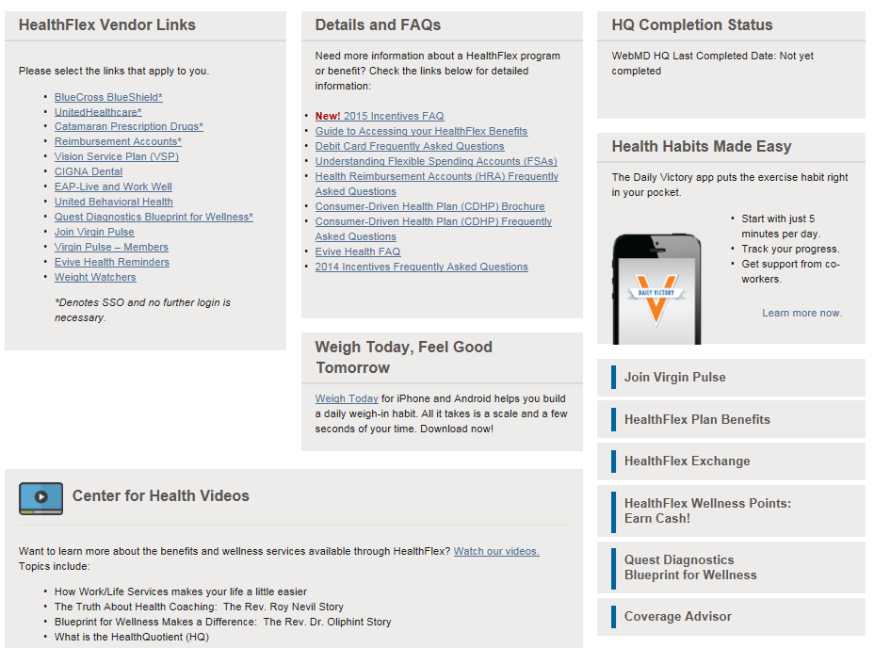
HealthFlex/WebMD Website

Slide 44
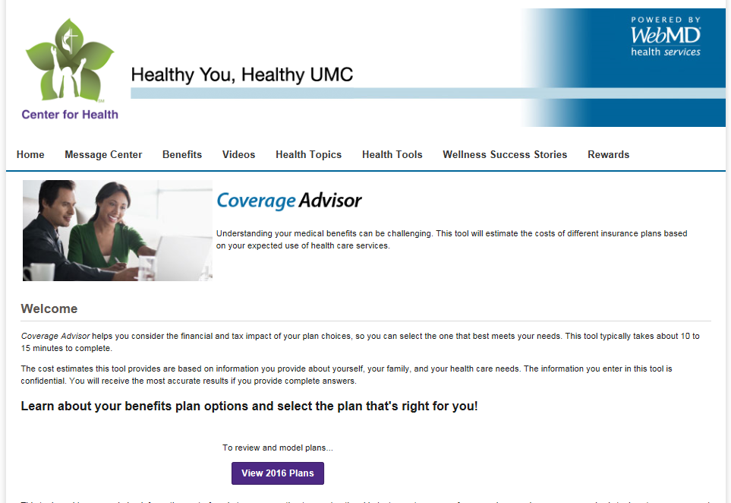
Coverage Advisor

Slide 45
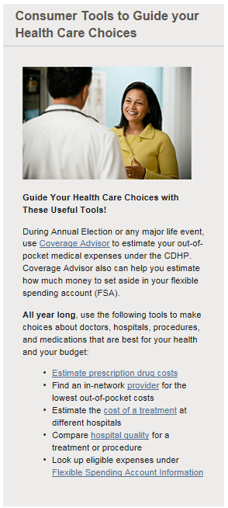
Coverage Advisor
Coverage Advisor is a tool available through WebMD to help you estimate the costs of your insurance plans
Estimate costs based upon your expected use of services
Customized based upon information you provide for each member who is covered
Annualized premiums
Coverage Advisor also provides general plan information
Co-insurance, co-pays, and out-of-pocket maximums
Notes:
HealthFlex will have some helpful tools to assist you in sorting through the 5 medical/pharmacy plan combinations to select the options that work best for you.
The first—WebMD’s Coverage Advisor—will be available in September. You can enter information about yourself, including:
-family members
-general health status
-number of doctor visits or hospitalizations expected (for you and family)
-how many medications you take (for you and family)
All information you enter in Coverage Advisor remains confidential and is not shared with your church or conference.

Slide 46
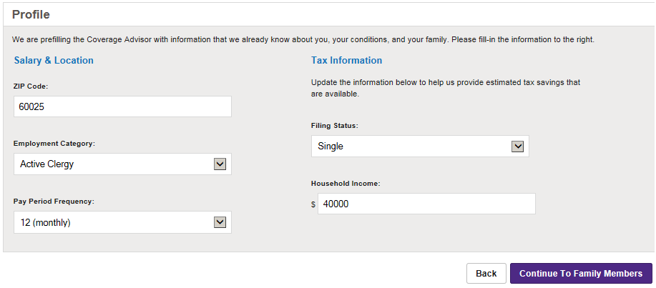
Coverage Advisor—Family Profile
Information may be prepopulated if you have used Coverage Advisor in the past. Make any necessary updates.
Your responses are confidential. Your church, annual conference, employer, HealthFlex, the General Board or your insurance carrier cannot access your responses. Businessolver is bound by the HIPAA Privacy Rule to protect your privacy.

Slide 47
Coverage Advisor—Family Profile
Enter information about health status of each family member to more accurately estimate costs per plan. General and detailed options available.
Your responses are confidential. Your church, annual conference, employer, HealthFlex, the General Board or your insurance carrier cannot access your responses. Businessolver is bound by the HIPAA Privacy Rule to protect your privacy.

Slide 48
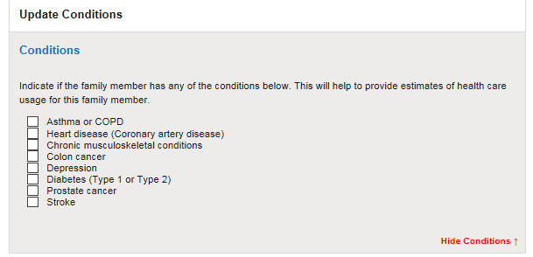
Coverage Advisor—Update Conditions
Enter detailed information regarding each member’s medical conditions.

Slide 49
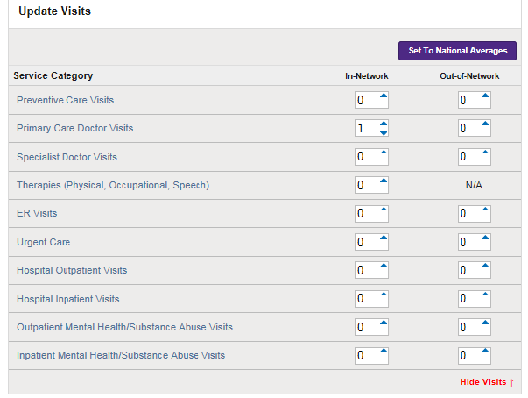
Coverage Advisor—Update Visits
Indicate expected number of visits by service type.

Slide 50
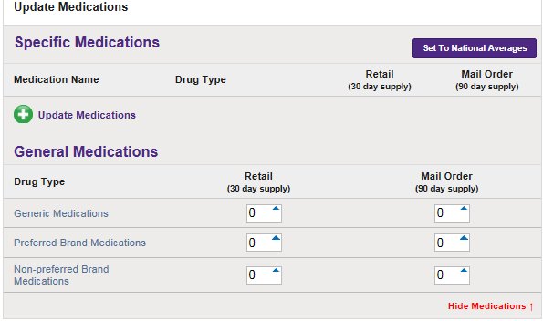
Coverage Advisor—Update Medications
Enter number of prescriptions you are filling at retail and/or mail order, and whether they are generic, preferred or non-preferred.

Slide 51
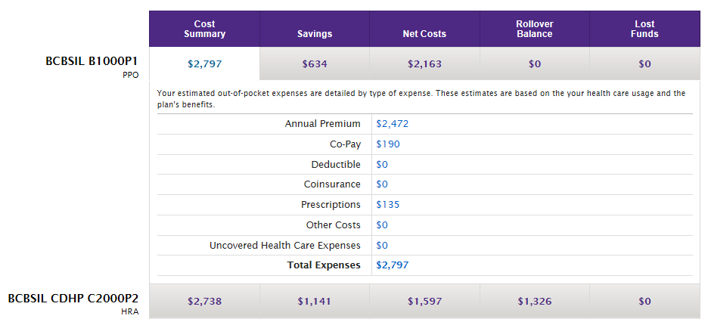
Coverage Advisor—Cost Summary by Plan
Receive cost comparison by plan, including premium and estimated out-of- pocket costs for each plan
Cost estimates are for illustration only. Actual costs may vary.

Slide 52
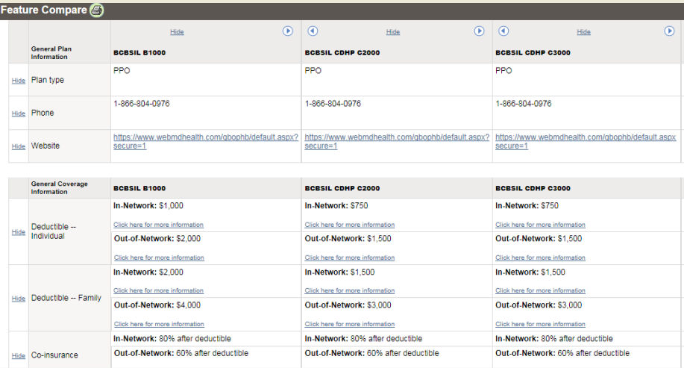
Coverage Advisor—Benefit Comparison

Slide 53
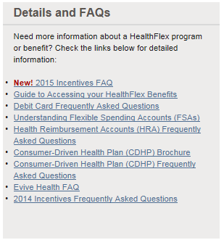
WebMD—Details and FAQs
Access more detailed information about HealthFlex benefits
CDHP and HDHP brochures
Guides to understanding FSAs, HRAs and HSAs
Frequently Asked Questions (FAQs)
Documents for understanding FSAs, HRAs and HSAs

Slide 54
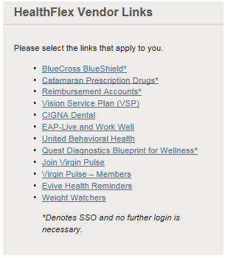
WebMD—HealthFlex Vendor Links
Ability to access all vendors (some through “single sign-on”)
Provider search
Estimate costs of certain procedures, services and medications
View claims history
See current Rx costs through OptumRx (formerly Catamaran)
Access health account information through WageWorks (“Reimbursement Accounts”)

Slide 55
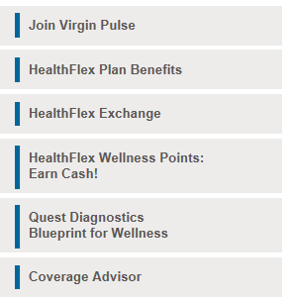
WebMD—HealthFlex Plan Benefits
Access the Reference Center in Businessolver
Summary Plan Description
Medical, Dental and Behavioral Health Benefit Booklets
Benefit summaries (Summary of Benefits and Coverage)
Reimbursement Account information
HealthFlex Notice of Privacy Practices

Slide 56
Businessolver Telephonic Support
Beginning in late October, you can contact Businessolver by phone for information regarding HealthFlex Exchange
Basic medical plan information (PPO vs. CDHP vs. HDHP)
Health Account information (FSA, HRA, HSA differences and limits)
MyChoice “best options”
Businessolver 1-844-688-1375
Monday – Friday 7a.m.-7 p.m. CST

Slide 57
Additional Conference Supports
Your plan sponsor may also provide tools to assist you with selecting your plans.
Plan premiums comparison
Defined contribution allocations by tier and participant type

Slide 58
Video Segment F: Annual Election

Slide 59
Annual Election (AE) November 4–19
During AE, you will make your elections for 2016
Use MyChoice to receive personalized medical/Rx plan options
Choose from the full suite of medical/Rx, dental and vision plans available
Use your defined contribution to “shop” for the plans
Elect to make FSA and/or HSA* contributions
If you do not make elections during AE, you will be automatically enrolled into the default plan(s) selected by your plan sponsor
* HSA contributions require enrollment in a high-deductible health plan (HDHP) and attestation that you are eligible per IRS guidelines

Slide 60
AE—MyChoice Online or Telephone
MyChoice asks you questions and uses your answers to recommend a medical plan
Questions assess your view of overall health, ability to handle a medical emergency, and level of risk aversion
Allows you to personalize your usage of medical services to improve the “Low-Cost” option
Plan premiums—included
Provides plan comparisons
You choose which plans to see side-by-side

Slide 61
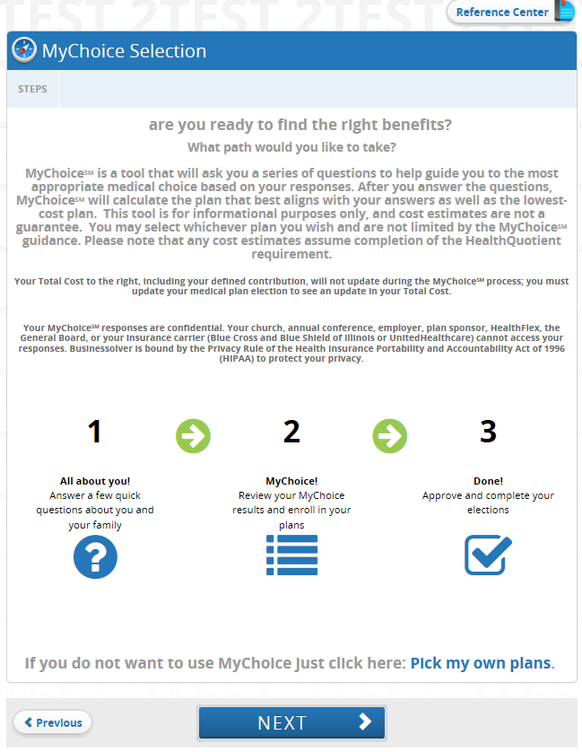
MyChoice—Selection
You can choose whether to continue to MyChoice or to Pick my own plans.

Slide 62
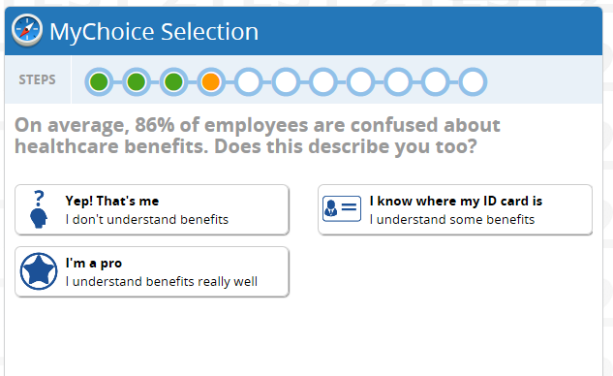
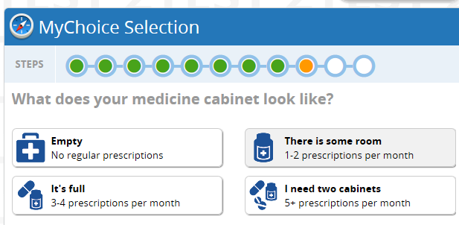
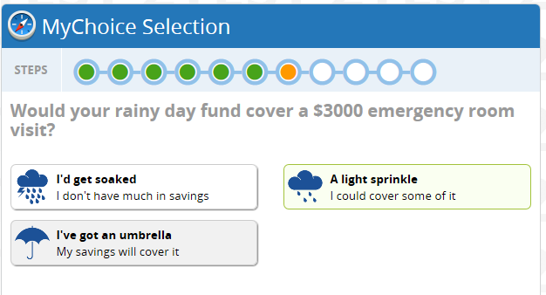
MyChoice—Information Gathering
Answer questions about health, risk tolerance, financial situation
Your responses are confidential. Your church, annual conference, employer, HealthFlex, the General Board or your insurance carrier cannot access your responses. Businessolver is bound by the HIPAA Privacy Rule to protect your privacy.

Slide 63
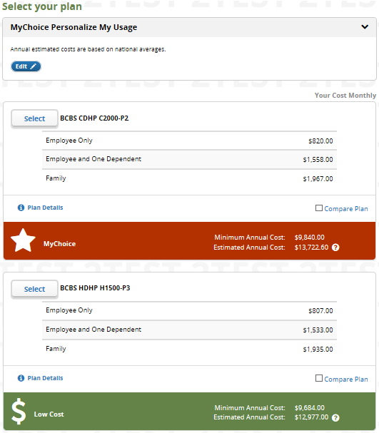
MyChoice—Medical/Rx Options
“Best MyChoice Match”
Based on your health and financial circumstances
“Low-cost” Option
If your primary goal is to limit out-of-pocket expenses
One plan can be both!
Options are a suggestion only, based on decision support tool. You can select any available plan(s). Cost estimates are for illustration only. Actual costs may vary.

Slide 64
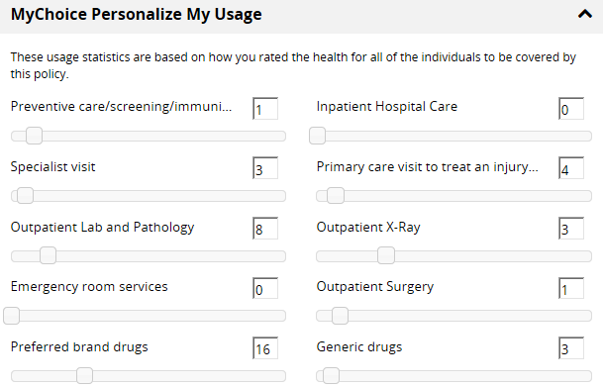
MyChoice—Personalize My Usage
Personalize usage for your entire family to help estimate costs
Your responses are confidential. Your church, annual conference, employer, HealthFlex, the General Board or your insurance carrier cannot access your responses. Businessolver is bound by the HIPAA Privacy Rule to protect your privacy.

Slide 65
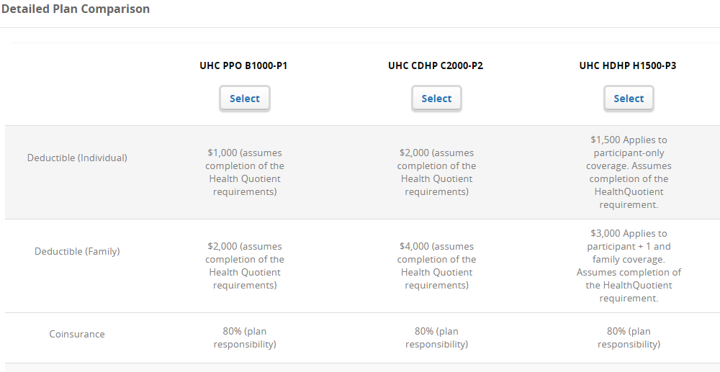
Businessolver—Plan Comparison
View side-by-side coverage comparisons

Slide 66
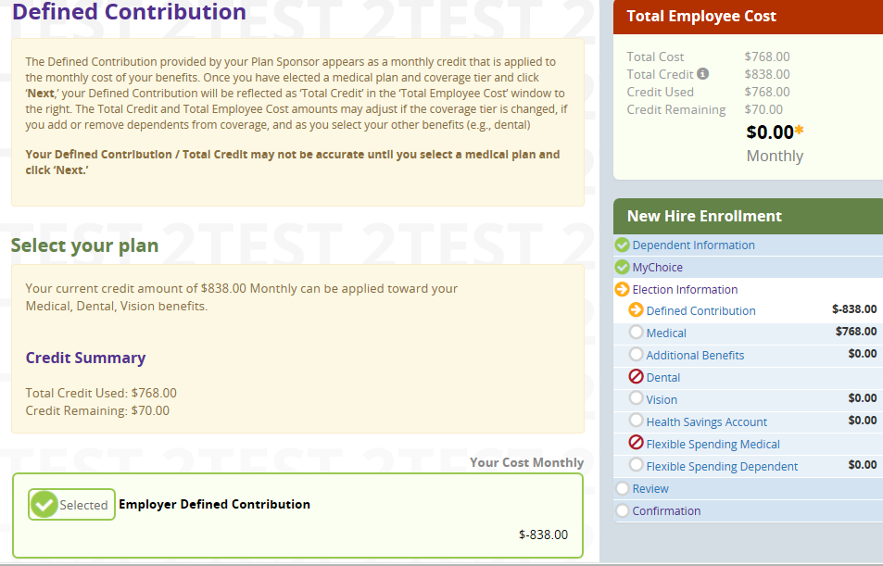
Defined Contribution
Defined contribution amount shows how much money you have to spend. Amount will change based upon tier or choosing to waive coverage.
Any unspent dollars will be added to your HRA or HSA (depending upon medical plan selected).

Slide 67
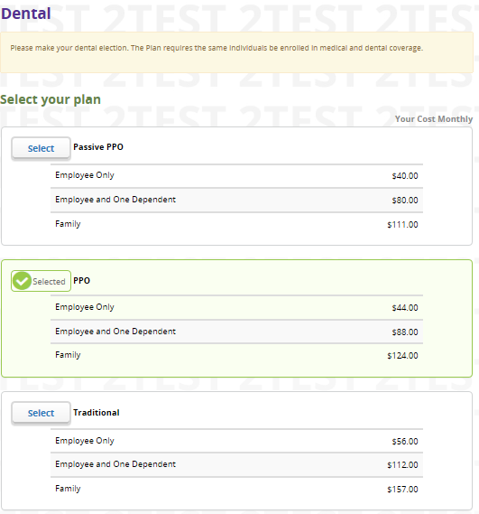
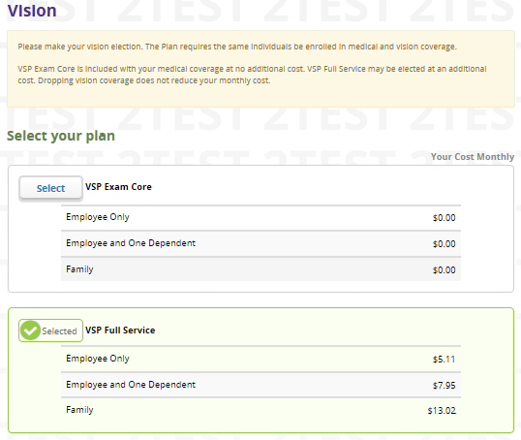
Dental and Vision
Choose the dental and vision plans that best fit your needs.

Slide 68
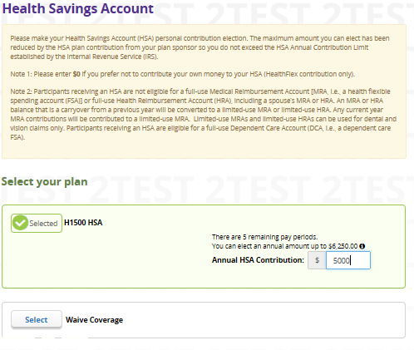
Health Savings Account (HSA)
HSA
If you elect to waive the Health Savings Account (HSA), your company contributions will not be contributed into an HSA.
If you are not eligible to open an HSA account, please click No to continue.
If you are eligible to receive the company contributions into your HSA but do not want to make your own contributions, please click Yes below to select the HSA account and enter $0.00 as your annual contribution.
HSAs are governed by the IRS. Please read all information provided.

Slide 69
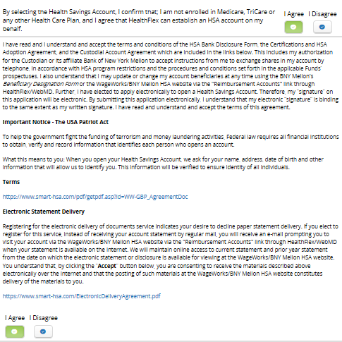
HSA Attestation
In order to receive individual or plan sponsor HSA contributions, you confirm you are eligible for an HSA and must agree to the terms and conditions provided.

Slide 70
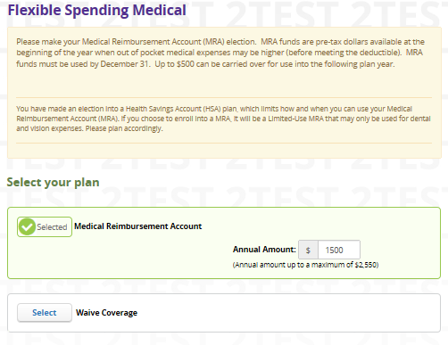
Medical Reimbursement Account (MRA)
Participants who elect an HDHP are notified that all MRA elections are limited-use only.

Slide 71
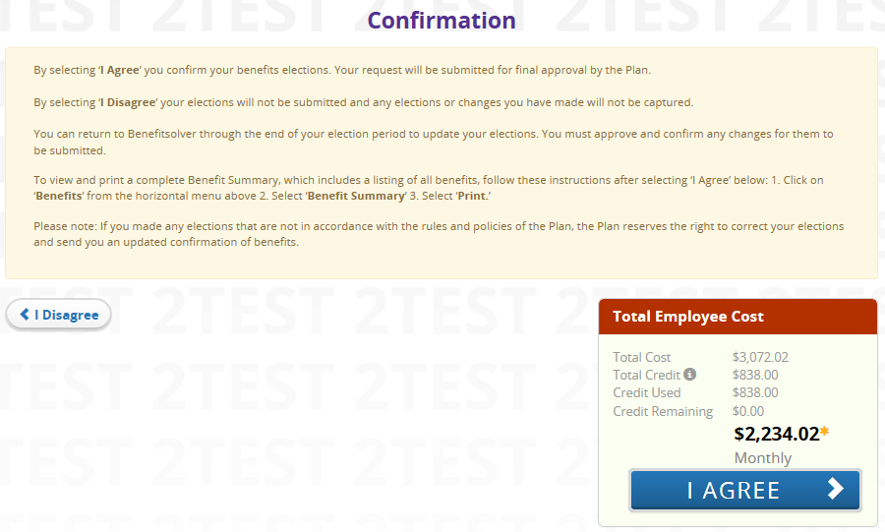
Review, Approve and Confirm
2-step process to review, approve and confirm elections

Slide 72
Timeline
Late August
First mailing from HealthFlex
November
Annual Election Nov. 4-19
Plan to make an election!
Online MyChoice support
September
Coverage Advisor Tool available
December
ID Cards are mailed
October
Annual Election communications from conference and HealthFlex; Businessolver telephonic support
January 2016
New benefits go live!

Slide 73
HealthFlex Exchange— Helps Church, Conference, You!
Benefits to Church, Conference
Benefits to Participants
Continue providing group health coverage in changing environment
Support cost sustainability
Manage year-to-year cost increases
Choices—select “best fit” plan for your needs
Use your employer contribution in the most meaningful way
Use decision support tools, assistance
Notes:
We are excited about this direction, because we believe HealthFlex Exchange offers benefits to the Church and Conference as well as to you. It’s a win-win.
We can continue to offer group health coverage and not terminate our plan due to high/unsustainable costs or fear of exceeding the Cadillac tax.
But you have greater choice—to choose a plan that really fits your needs. You can take the amount of defined contribution we give you and use it to purchase a more-expensive plan, or to purchase a less-expensive plan and add dental and additional vision benefits or possibly have some left over in an HRA or HSA. It’s your choice. And HealthFlex will give you good decision support tools to help you select the HealthFlex plan that best fit your needs.

Slide 74
Notes:
This presentation is just an overview introduction to HealthFlex Exchange.
You’ll learn much more by attending a HealthFlex Exchange workshop in September/early October.
Watch for an announcement with workshop dates and location, as well as a brochure and other materials coming your way in late summer.
The HealthFlex Exchange handout also provides a good outline of what HealthFlex Exchange is all about (pass out handout below):

